Slide 1
Worksheets Need to Get a Life!
Amy Walls
Putnam City Schools
Social Studies Coordinator

Slide 2
What Do We Mean by “Worksheet”?
A printed page that a child completes
with a writing instrument.
Typically no other materials are needed.

Slide 3
Traditional worksheet formats:
multiple choice questions
matching exercises
handwriting practice
coloring pages
math problems
fill-in-the-blank book reports
word searches and crossword puzzles

Slide 4
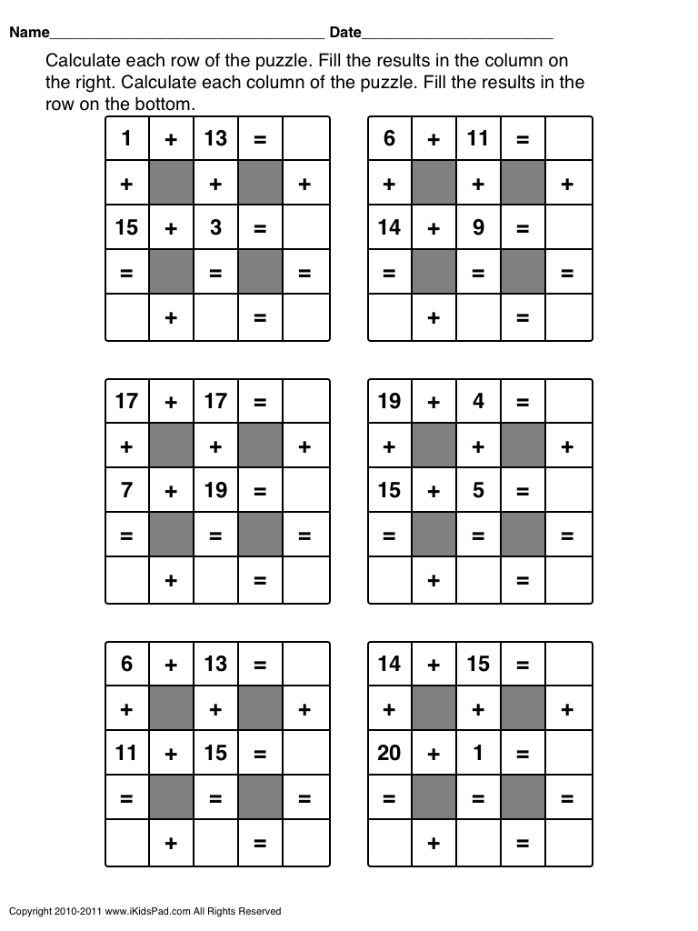
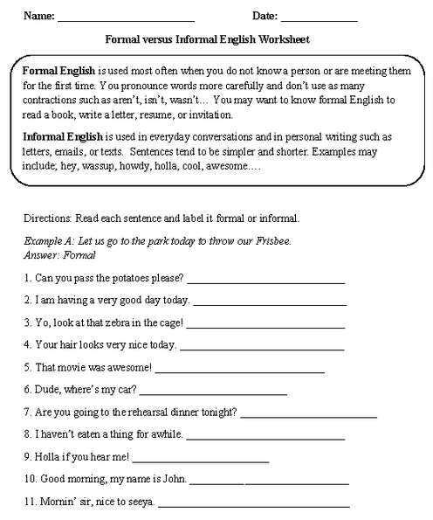

Slide 5
Not Everything that is Copied is a Worksheet

Slide 6
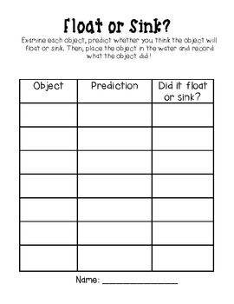
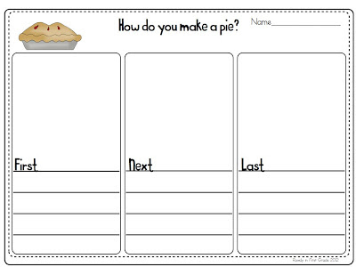

Slide 7
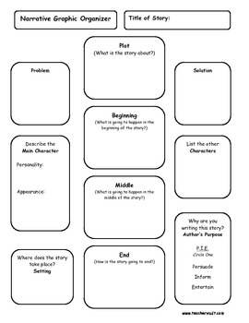
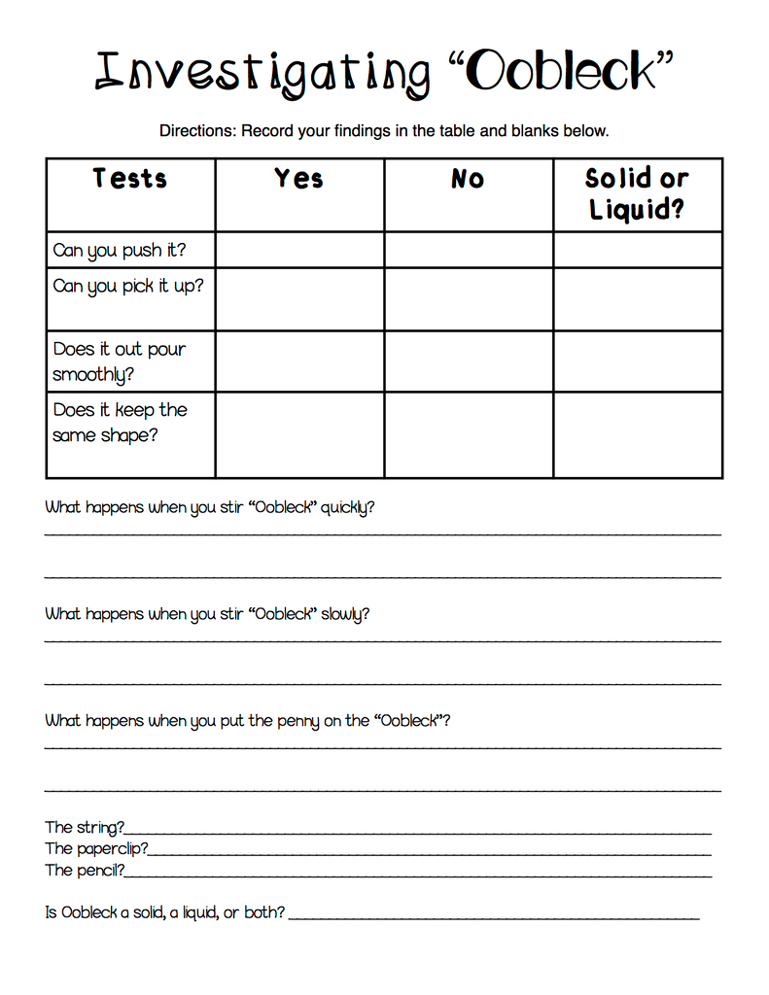

Slide 8
Three Big Questions
What are some perceived benefits of worksheets?
What are some worksheet-related woes
from a teacher perspective?
What are some worksheet-related woes
from a student perspective?

Slide 9
The Trouble with Worksheets

Slide 10
Worksheets are problematic for students
with academic challenges.
Worksheets are symbolic activities that are
difficult for children who are concrete thinkers.
Children with reading difficulties will feel inadequate to even begin a worksheet- because it requires the
skill of following written directions.
Children who are not easily motivated, will find
worksheets to be tedious.

Slide 11
Worksheets offer additional challenges
for students with physical disabilities
Children who have difficulty with visual tracking
or eye-hand coordination will most certainly find
worksheets to be a challenge.
Children with fine motor limitations will find
holding a pencil and filling out sheets difficult to do.
Children who are easily distracted will most likely struggle with staying focused on worksheets.

Slide 12
Worksheets are very limiting.
Worksheets offer no choice at all. The directions
are given, and the child is expected to follow them.
Worksheets typically do not allow higher-level
thinking. Most worksheets have just one right
answer, or one way to complete them.

Slide 13
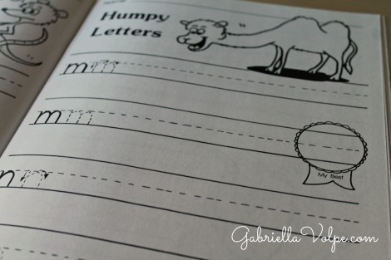
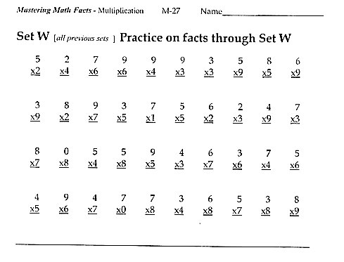
But… sometimes a worksheet is the best tool for practice.
Notes:
Sometimes, a worksheet is all that will do. When my kids have created letters in a variety of hands-on ways, it’s time to practice writing them. You need a handwriting worksheet for that. When kids have explored math concepts in hands-on ways, a worksheet may be helpful for additional practice.

Slide 14
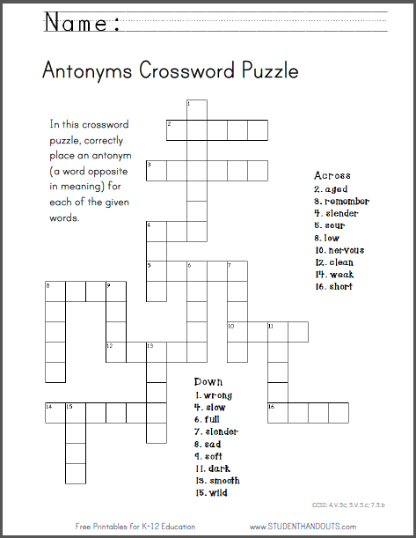
Worksheets to Avoid… Always

Slide 15
Using Worksheets Wisely

Slide 16
It’s all about time
and value.

Slide 17
It’s all about time.
Determine how long the average student in your class will need to complete the worksheet successfully.
Set a timer.
Have a plan in place for early finishers.
Do not expect students who are struggling
to complete every problem.

Slide 18
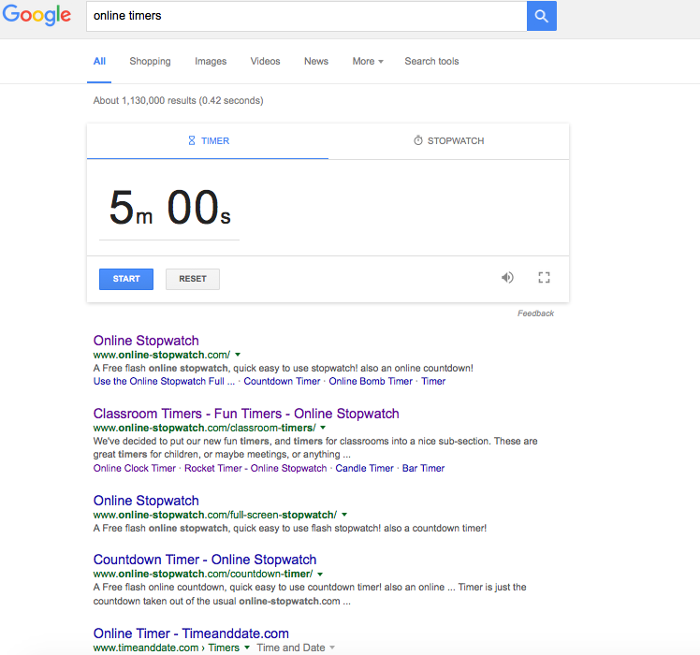
Notes:
https://www.google.com/search?q=online+timers&ie=utf-8&oe=utf-8

Slide 19
Modify Worksheets to Create Shared Learning Experiences and Meaningful Skills Practice

Slide 20
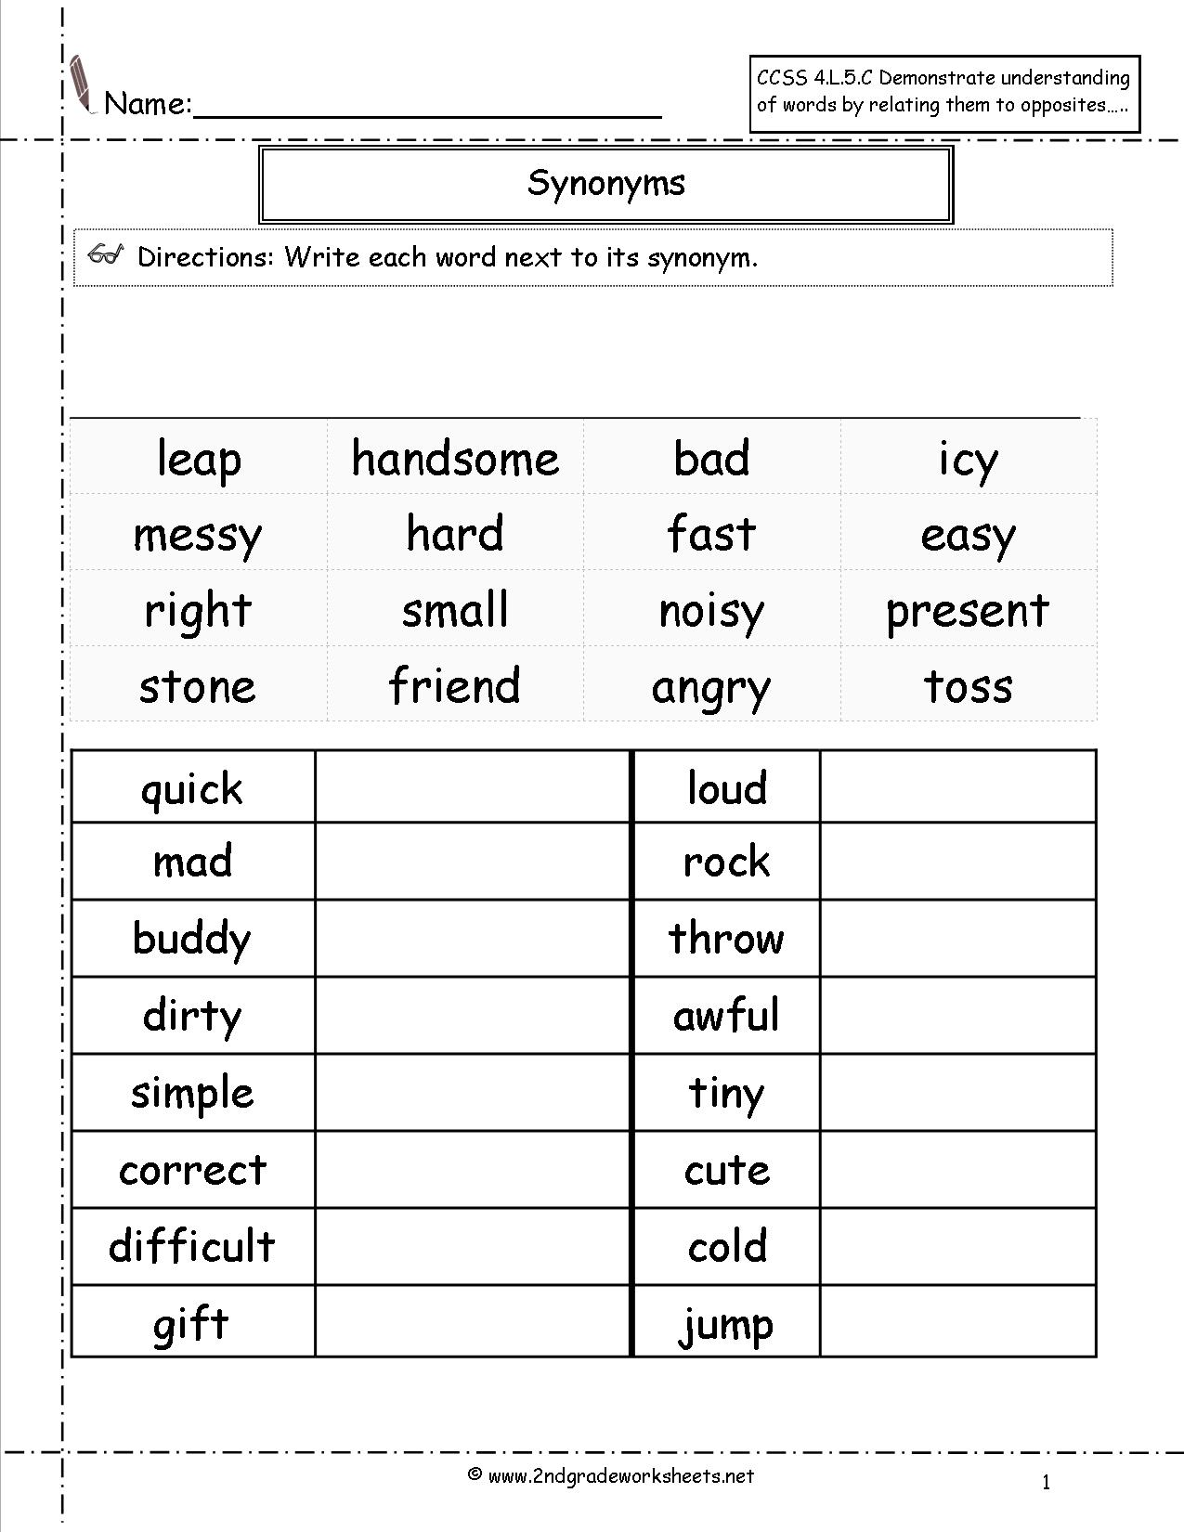

Slide 22
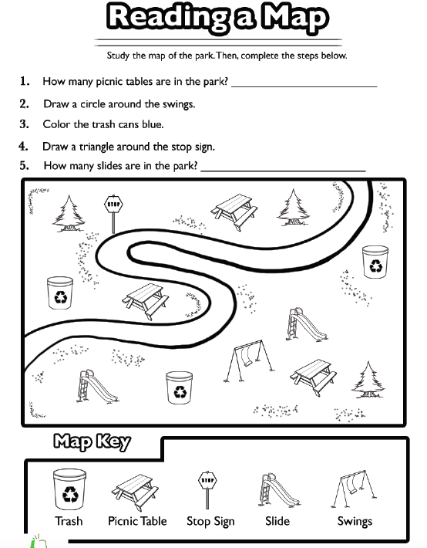
Notes:
https://www.education.com/worksheet/article/reading-a-map/

Slide 23
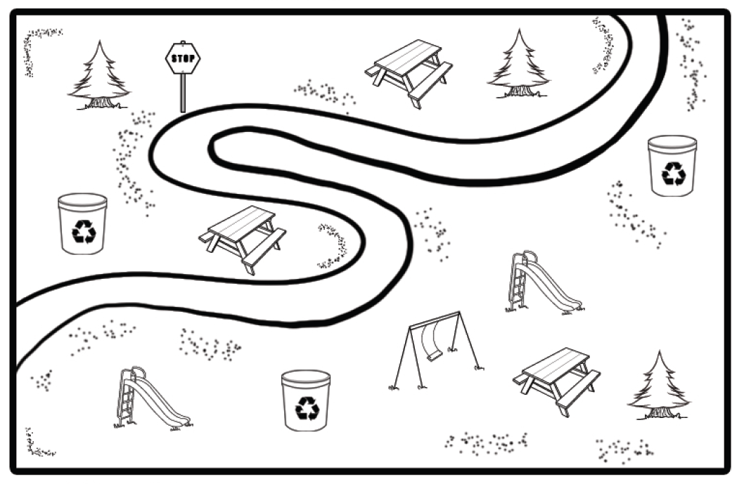

Slide 24
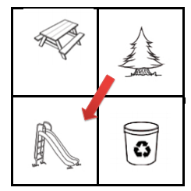
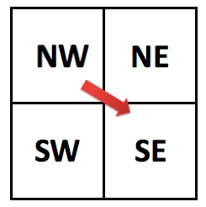

Slide 25
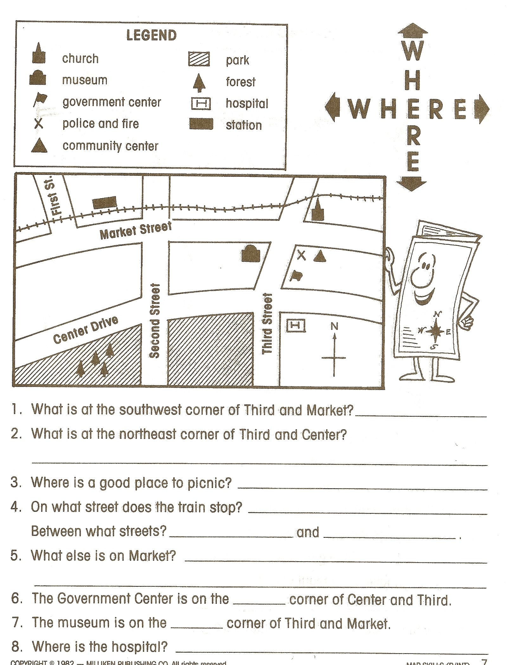

Slide 26
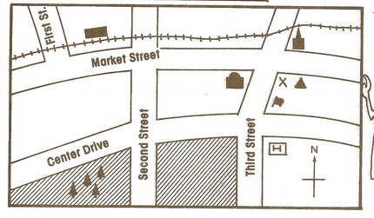
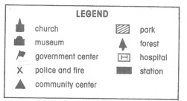
Notes:
Complete compass rose
Add Marcus and Matthew

Slide 27
In your group, describe the routes Marcus and Matthew will need to take to get to the community center for soccer practice.
Use at least three directional words in your description.
(north, east, south, west, northeast, southeast, northwest, southwest)
Brownie points are given for creative descriptions!
Team Roles:
- Director
- Scribe
- Embellisher

Slide 29
Figurative Language Puzzles
Notes:
https://www.teacherspayteachers.com/Product/Figurative-Language-Puzzles-FREEBIE-1029961

Slide 30
Notes:
http://weebly-file/1/3/1/2/13121092/b_u_m_p_directions_.pdf

Slide 31
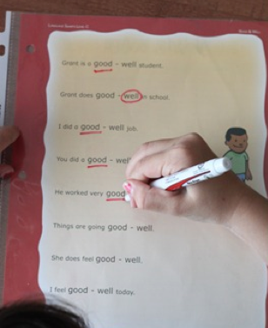
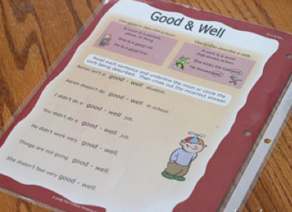
Dry Erase Team Challenge

Slide 32
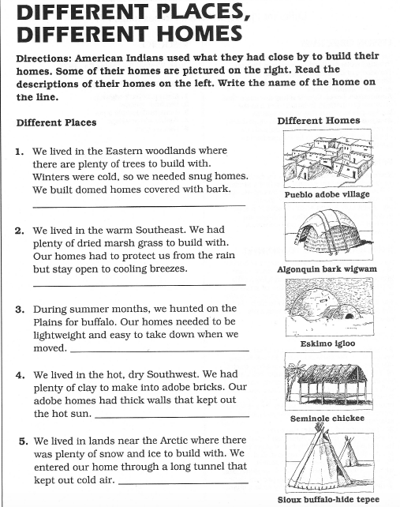

Slide 33
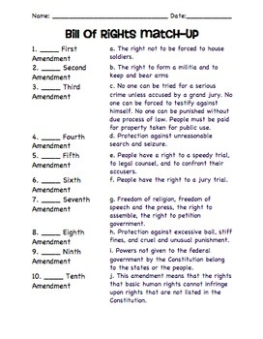

Slide 34
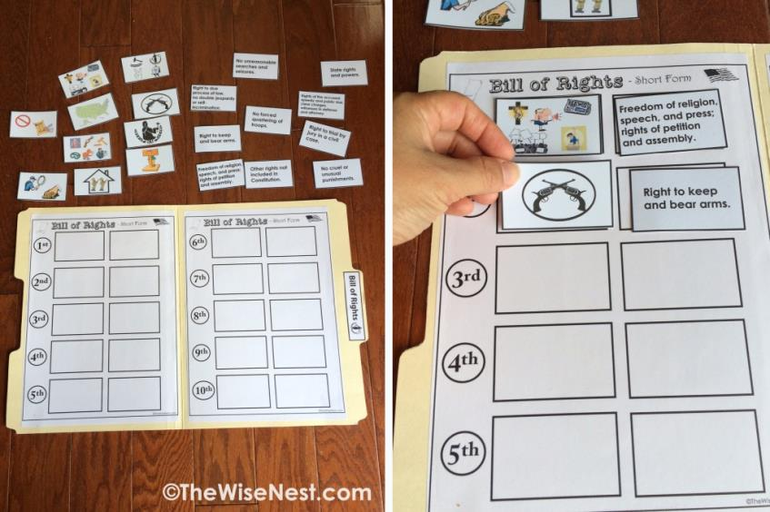
Notes:
http://thewisenest.com/bill-rights.html

Slide 35
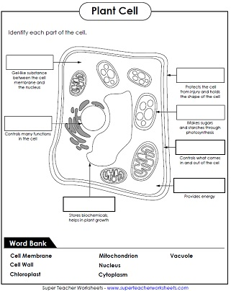

Slide 36
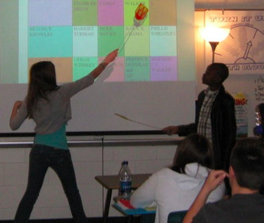
Flyswatter Face Off
Notes:
https://www.teacherspayteachers.com/Product/FREEBIE-Vocabulary-Practice-2843213
http://weebly-file/1/3/1/2/13121092/star_wars_review.pdf

Slide 37
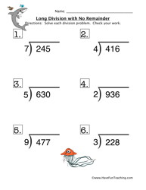

Slide 38
Task Cards
Notes:
http://the-teacher-next-door.com/index.php/blog/65-blog-other/159-16-ways-to-use-task-cards

Slide 39
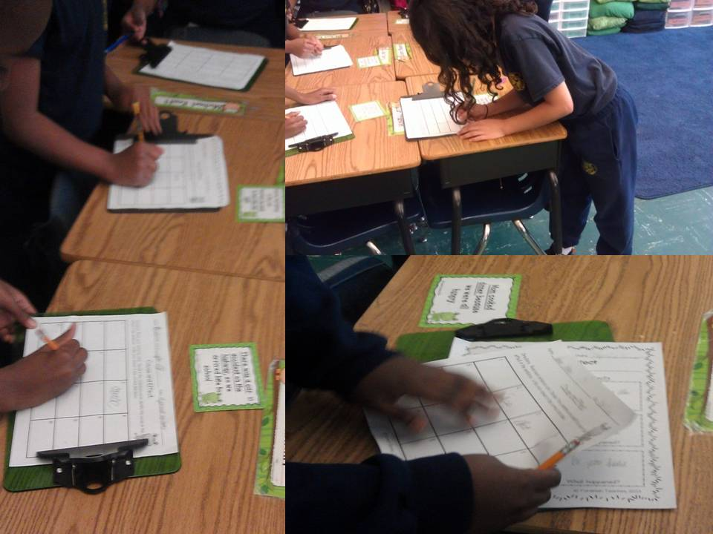
Notes:
https://www.youtube.com/watch?v=-XYGT4kwvLM

Slide 40
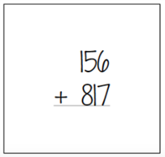
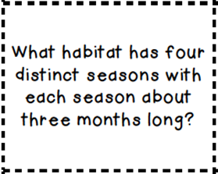
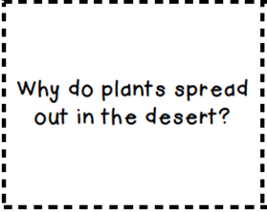

Slide 41
Mirror Game
Notes:
Have your kids sit facing each other with whiteboards. Ask a question from a task card and then the kids answer it without showing their partner. Chose a signal word or phrase (GO!), and kids show their partner the answer. If they "mirror" each other (both have identical answers) and are right, they can add two tally points to their board. If only one person is right, their "team" still gets one tally point.

Slide 42
You have to check this out!
Notes:
http://www.fcrr.org/resources/resources_sca.html

Slide 43
What Would YOU Do?

Slide 44
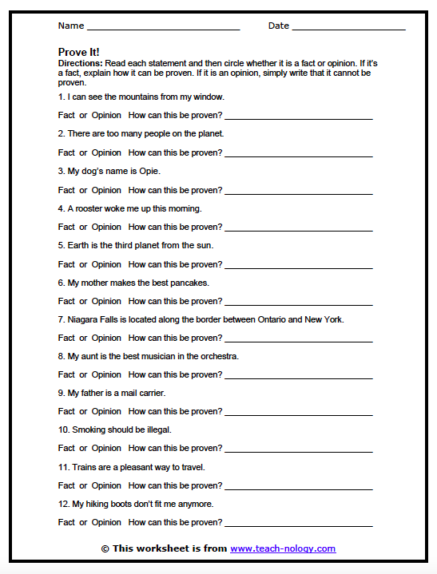

Slide 45
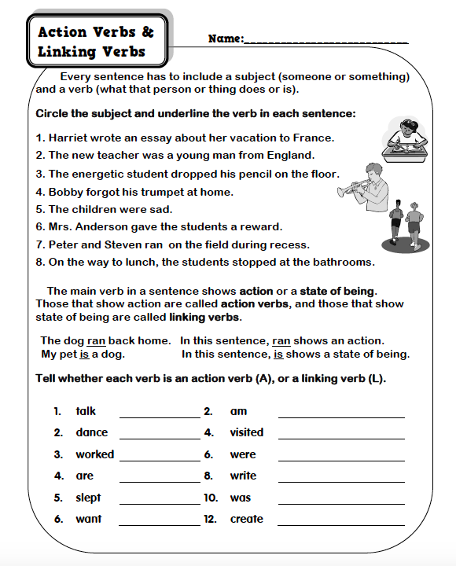

Slide 46
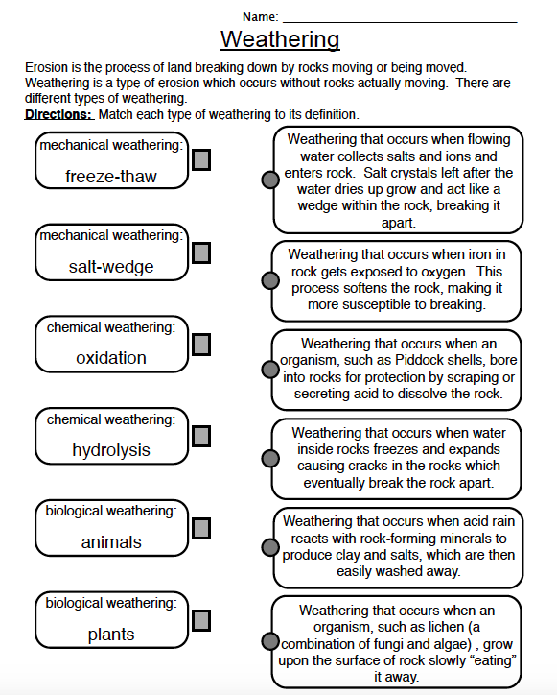

Slide 47
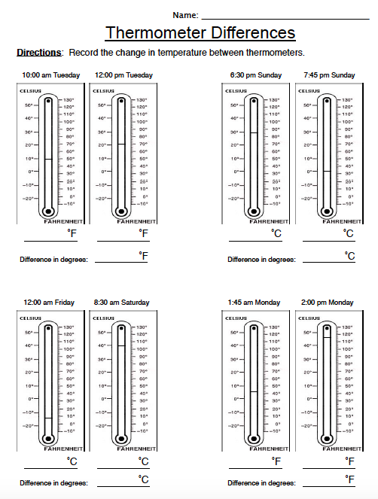

Slide 48
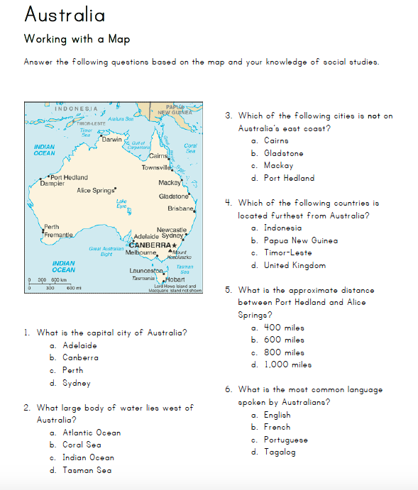

Slide 49
Engaging Alternatives to Worksheets

Slide 50
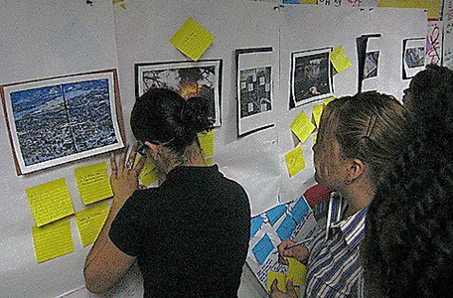
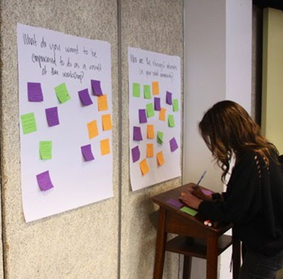
Gallery Walk / Written Reviews
Notes:
http://www.theteachertoolkit.com/index.php/tool/gallery-walk

Slide 51
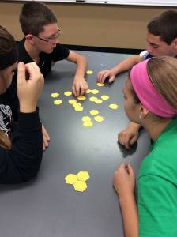
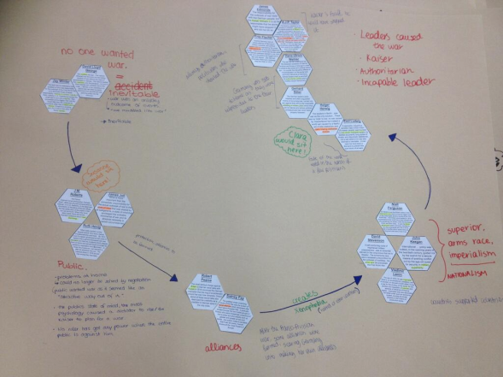
Making Connections
Notes:
http://www.classtools.net/hexagon/
http://weebly-file/1/3/1/2/13121092/hexagon_directions.pdf

Slide 52
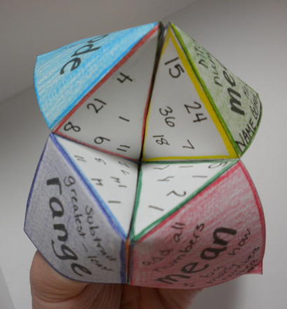
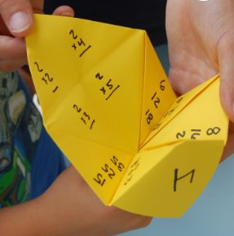
Notes:
http://www.teachersnotebook.com/product/JuliaCasteel/place-value-cootie-catcher-freebie
http://www.123homeschool4me.com/2016/04/cootie-catchers-math-games.html
http://classroomgamenook.blogspot.com/2016/05/using-cootie-catchers-for-reading.html
http://jdaniel4smom.com/2014/11/cootie-catcher-learning-games-blank-template.html

Slide 53
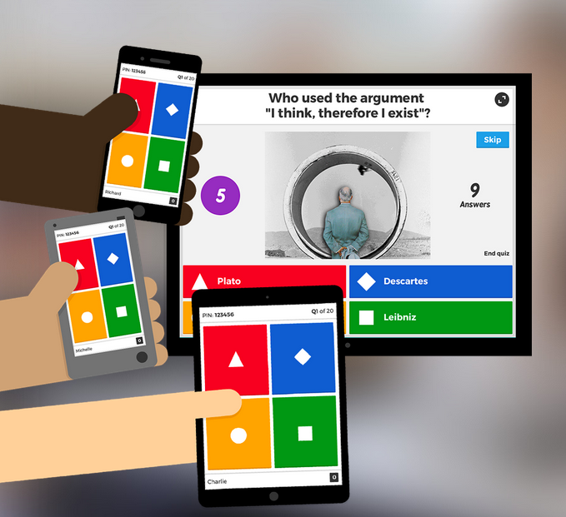
K H O O T !
Notes:
https://kahoot.it/#/
https://getkahoot.com/
https://getkahoot.com/how-it-works
https://www.youtube.com/watch?v=BJ3Er1-tCMc

Slide 54
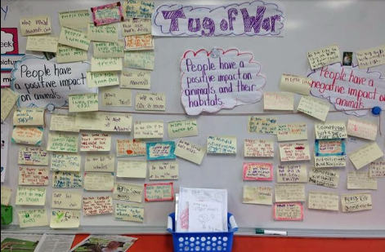
Notes:
http://www.createdreamexplore.com/2014/05/how-about-tug-of-war-making-thinking.html

Slide 55
Plickers
Notes:
https://plickers.com
https://www.youtube.com/watch?v=DfUB05xiIGM
https://www.youtube.com/watch?v=HCM9nqikcjs
https://www.youtube.com/watch?v=Qpx56rjCVjQ

Slide 56
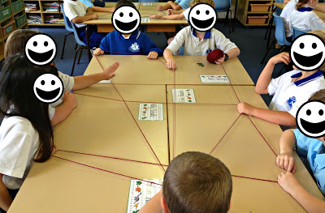
Web of Understanding
Notes:
http://mrsbiancaaudet.edublogs.org/2013/08/20/weave-a-web-of-understanding/

Slide 57
One Minute Master
Each student will write for one minute
about the most significant (useful, meaningful,
awful, disturbing, effective, helpful)
thing they learned.
Then students will trade with a partner and
respond (agree/disagree/build).

Slide 59
Credits
http://www.gabriellavolpe.com/day-10-alternatives-to-worksheets-for-the-child-with-special-needs/
http://www.pre-kpages.com/no_more_worksheets/
http://www.themeasuredmom.com/are-worksheets-good-or-bad/

